Slide 1
Extremely
Time-consuming
Project
Presentation
2023.5.15
朱宇轩 赵子豪

Slide 2
Content
Fiber Optic Communication
APD Area Review
Paper Reproduction

Slide 3
Content
Noise and Main parameters
In0.53Ga0.47As
SACM APD
Ge/Si APD
Reduce the thickness of the multiplier layer
In0.52Al0.48As
Three mesa
Two-layer absorption
Impact Ionization Engineering
Longer wavelength
APD Area Review

Slide 4
Content
Determination of basic parameters
Electrical field
Workmanship
Ohmic contact
Graded band
Initial value
Paper Reproduction
Simulation attempt
N17
P3
N18
Dual Charge Layers
Theoretical analysis
P15
P13
Three mesa
Structure B comparison
Structure C comparison
Reliability
Unintentional doping
Gradient problem
Current dependent
Dark current
Light current

Slide 5
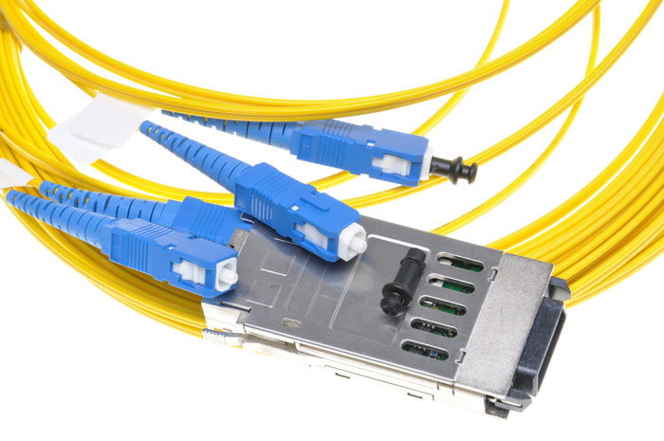
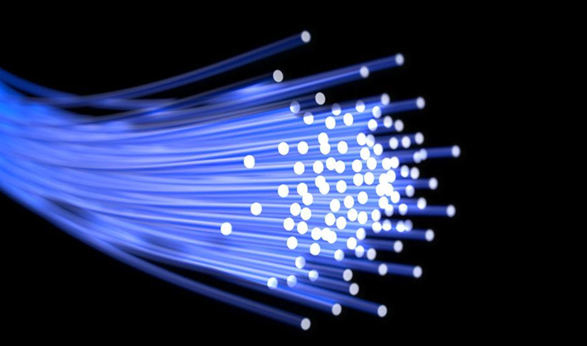
Fiber Optic
Fiber Optic Communication

Slide 6
Fiber Optic
Reducing loss

Slide 7
Silicon Dioxide
optical transparency
mechanical strength
SiO2 absorption
electromagnetic interference resistance
cost-effectiveness

Slide 8
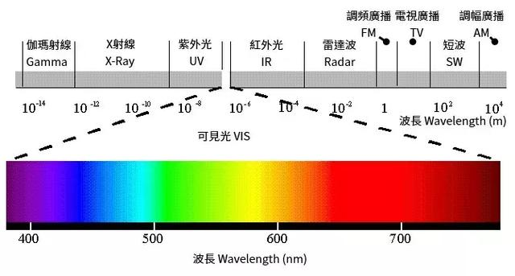
Silicon Dioxide
bonding electrons
SiO2 light absorption
vibration mode of the Si-O bond network

Slide 9
Silicon Dioxide
short-wavelength
Rayleigh scattering
Scattering
high light intensity
spontaneous Raman scattering
brillouin scattering
[1] https://www.sohu.com/a/580776421_120733531

Slide 10
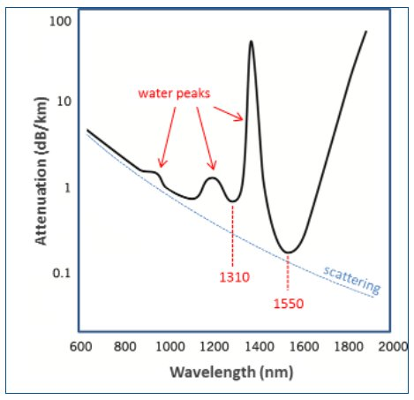
Water Vapor
water vapor light absorption
[1] Carter, G.A. (1993). "Relationship of leaf spectral reflectance to chloroplast water content determined using NMR microscopy". Remote Sensing of Environment. 46 (3): 305–310.
[2] Rossel, R.A.V. (1998). "Laboratory evaluation of a proximal sensing technique for simultaneous measurement of soil clay and water content". Geoderma. 85 (1): 19–39.

Slide 11
Content
Noise and Main parameters
In0.53Ga0.47As
SACM APD
Ge/Si APD
Reduce the thickness of the multiplier layer
In0.52Al0.48As
Three mesa
Two-layer absorption
Impact Ionization Engineering
Longer wavelength
APD Area Review

Slide 12
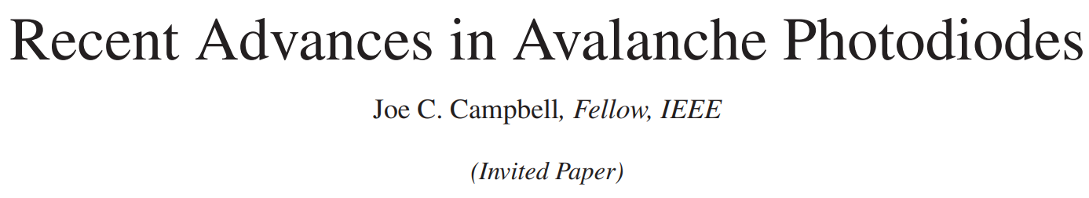
APD

Slide 13
Performance Index
Thermal noise
Noise
Particle noise
Gain
Bandwidth
Core Index
Gain-bandwidth product
Excess noise factor

Slide 14
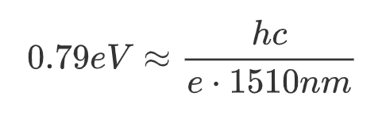
In0.53Ga0.47As
Bandgap: 0.79eV
Advantage
Lattice constant: 5.868Å
matching well with InP
[4] Cook, L. W. Electron and hole impact ionization coefficients in InP determined by photomultiplication measurements[J]. Applied Physics Letters, 1982, 40(7): 589-591.

Slide 15
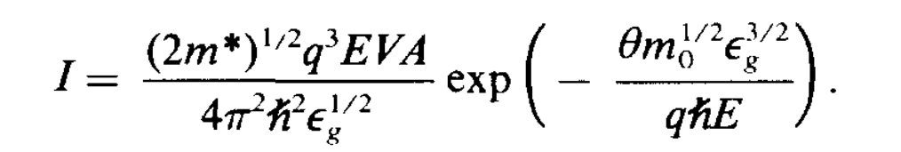
InP
Low dark current
Pure hole carrier
Low noise
InP

Slide 16
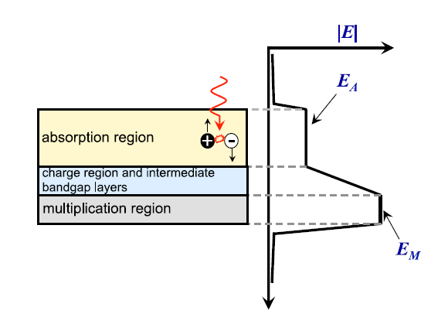
SACM APD
relatively weak absorption efficiency
an absorption layer of at least 2.5 μm
longer transition time
lower Gain–bandwidth product

Slide 17
SACM APD
low Gain–bandwidth product
Produce more noise than Si
Cannot be integrated with the silicon based CMOS process
Expensive
Poor crystal quality
Complex manufacturing process
Disadvantage

Slide 18
Ge/Si
Absorption region
Ge
Multiplication region
Si
Wavelength is calculated to be 1.1 μm
Low absorption efficiency near the cutoff wavelength
Lattice mismatch
[5] Shah V A, et al. Effect of layer thickness on structural quality of Ge epilayers grown directly on Si(001)[J]. Thin Solid Films, 2011, 519(22): 7911-7917.

Slide 19
Lattice Mismatch
Lattice mismatch
Rough surface of Ge
High density of dislocation defects
Dark current
Power consumption
Noise
[6] Masini G, et al. High responsitivity near infrared Ge photodetectors integrated on Si[J]. Electronics Letters, 1999, 35(17): 1467-1468.
[7] Wei Y, et al. Analysis of dark current dependent upon threading dislocations in Ge/Si heterojunction photodetectors[J]. Microelectronics International, 2012, 29(3): 136-140.

Slide 20
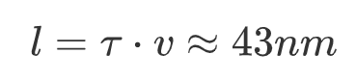
Multiplication layer thickness

Slide 21
In0.52Al0.48As
bandgap 1.437 eV
Replace InP
Reduce noise
matching lattice constant
As multiplication layer

Slide 22
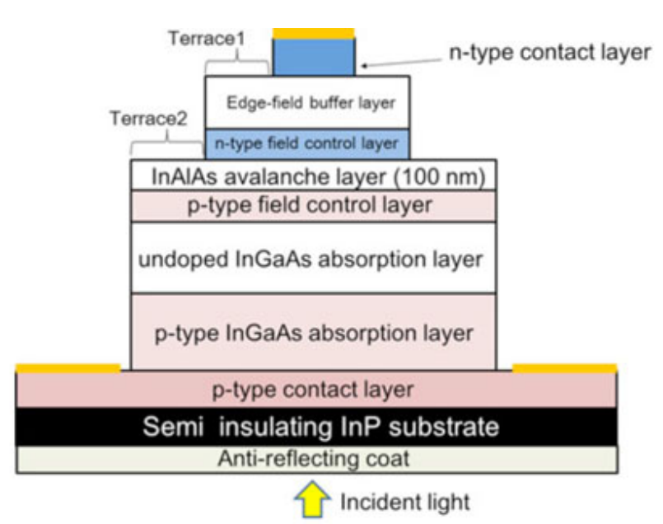
Three mesa
high electric field region is limited to the space directly below the top surface
avoiding the need for a guard ring
reduces the electric field at the edges
preventing edge breakdown and surface current leakage

Slide 23
Two absorption region
Increasing electric field
partially depleted p+
Enlarging gain
i-type depleted
Increasing absorption efficiency

Slide 24
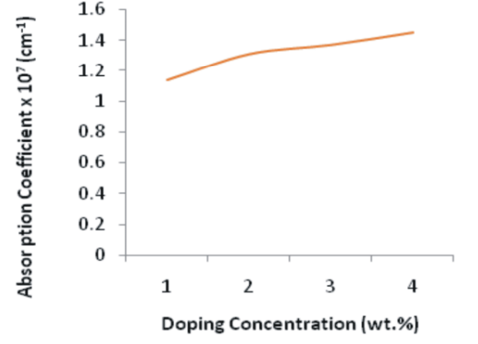
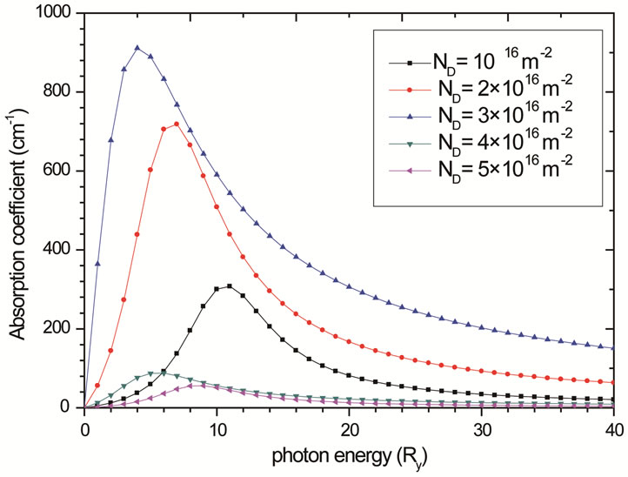
Two absorption region
[8] Alpha, M. & Daniel, Thomas. (2015). Effect of Doping Concentration on the Electrical and Optical Properties of Zn: SnO 2. IOSR Journal of Applied Physics. 7. 38-44. 10.9790/4861-07323844..
[9] Dakhlaoui, H. (2012) Effect of the Doping Layer Concentration on Optical Absorption in Si δ-Doped GaAs Layer. Optics and Photonics Journal, 2, 140-144. doi: 10.4236/opj.2012.23020.

Slide 25
Impact Ionization Engineering
Materials with smaller bandgap width
Enhance higher-ionization-rate carrier collision ionization
I2E
Cascade low-noise gain regions

Slide 26
Bigger Wavelength
Capacity crunch
Increasing the bandwidth of optical fiber transmission system
More data can be transmitted on same infrastructure

Slide 27
Bigger Wavelength
Higher transmission capacity
WDM
(Wavelength Division Multiplexing)
Improving data transmission efficiency

Slide 28
Content
Determination of basic parameters
Electric field
Workmanship
Ohmic contact
Graded band
Initial value
Paper Reproduction
Simulation attempt
N17
P3
N18
Dual Charge Layers
Theoretical analysis
P15
P13
Three mesa
Structure B comparison
Structure C comparison
Reliability
Unintentional doping
Gradient problem
Current dependent
Dark current
Light current

Slide 29
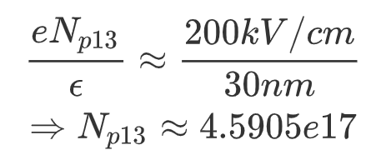
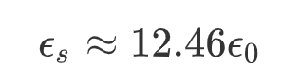
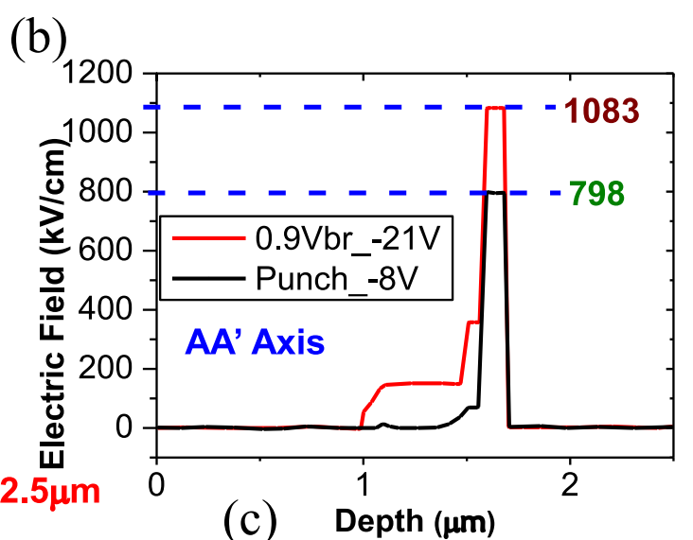
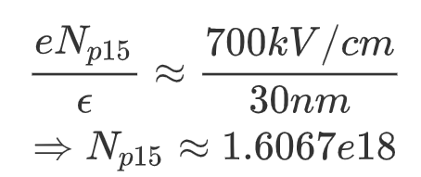
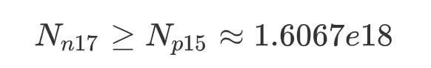
Electrical field
In0.52Al0.48As
[10] M. Littlejohn, K. Kim, and H. Tian, ``High-Field Transport in InGaAs and Related Heterostructures,'' in Bhattacharya, section 4.2, pp. 107-116.

Slide 30
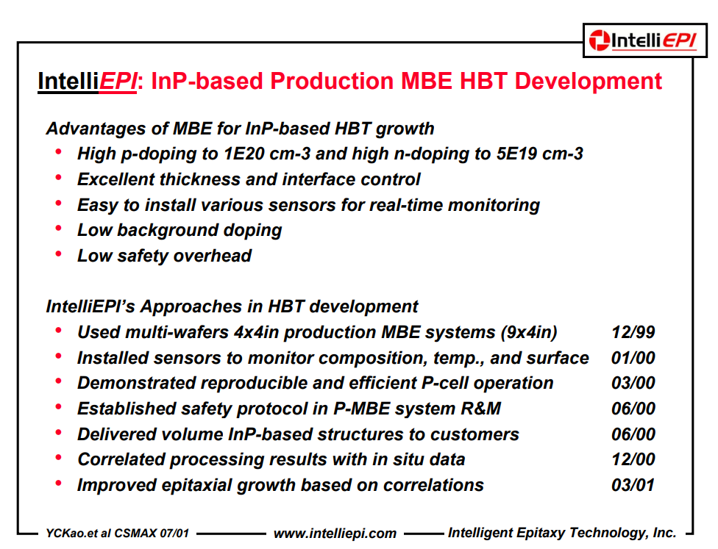
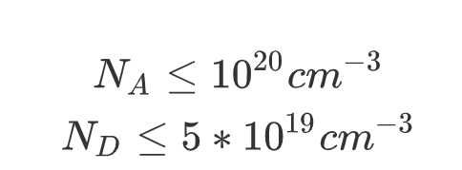
Workmanship

Slide 31
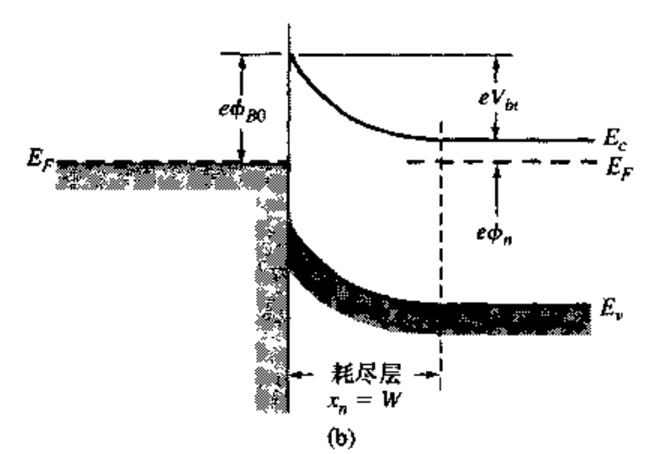
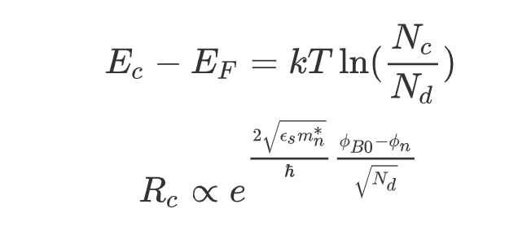
Ohmic Contact

Slide 32
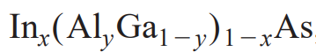
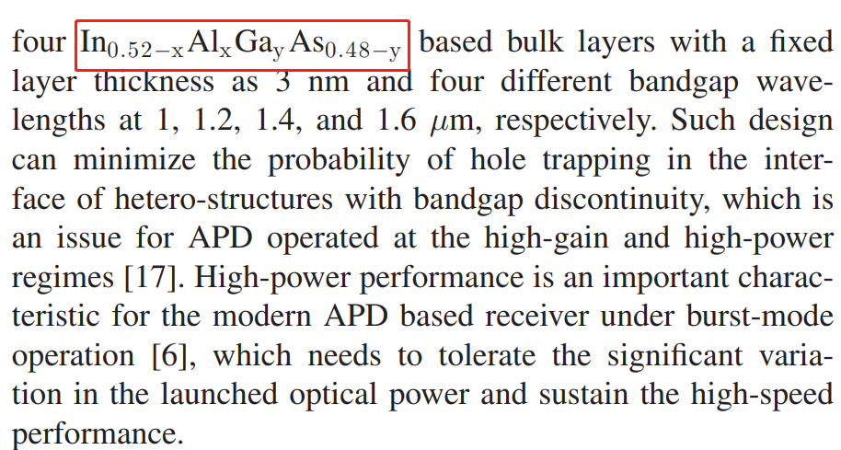
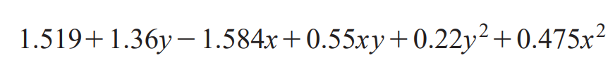
Graded Band
Material | Wavelength(um)
In0.61Al0.04Ga0.35As | 1
In0.58Al0.03Ga0.39As | 1.2
In0.55Al0.06Ga0.39As | 1.4
In0.52Al0.12Ga0.36As | 1.6

Slide 33
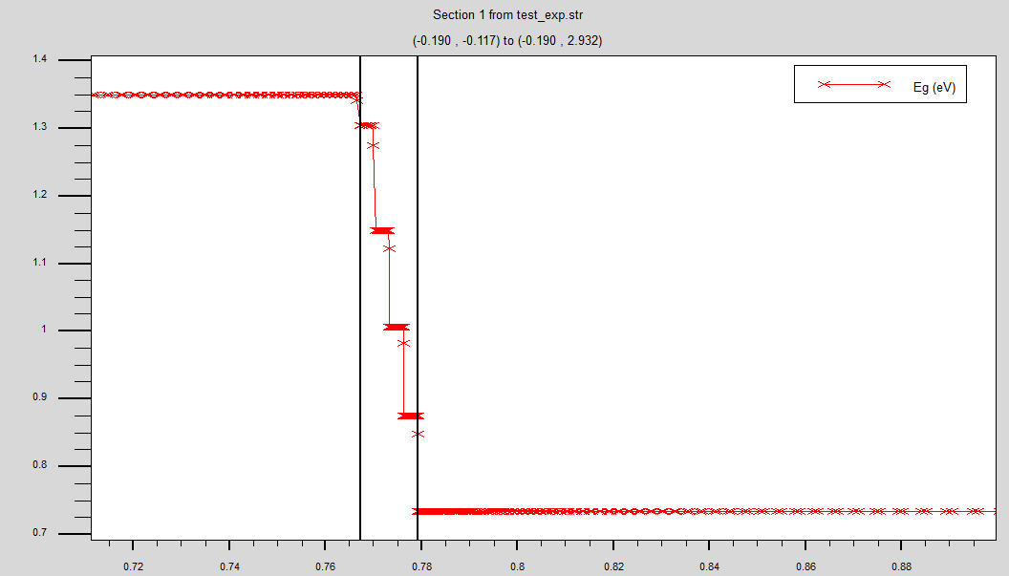
Graded Band
Material | Wavelength(um)
In0.2Al0.500Ga0.300As | 1
In0.2Al0.367Ga0.433As | 1.2
In0.2Al0.234Ga0.566As | 1.4
In0.2Al0.100Ga0.700As | 1.6

Slide 34
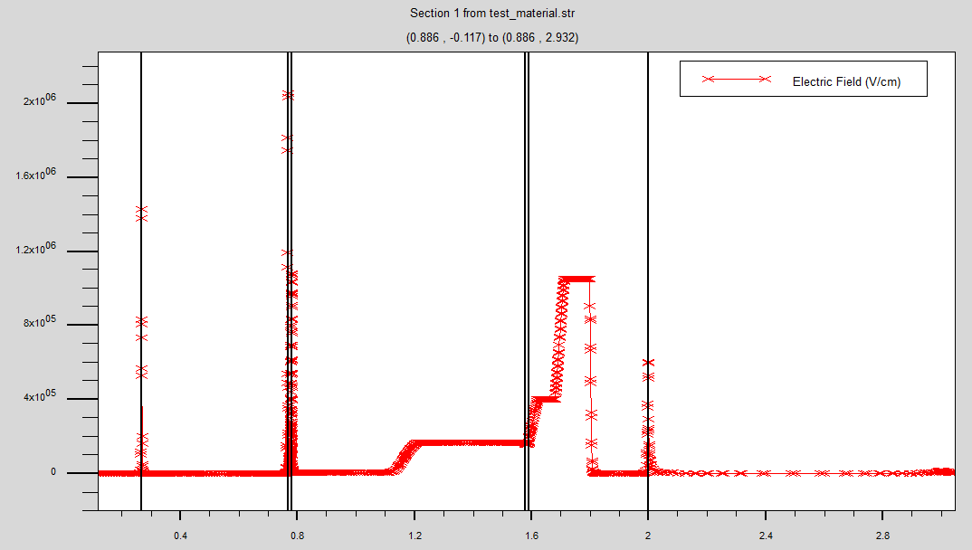
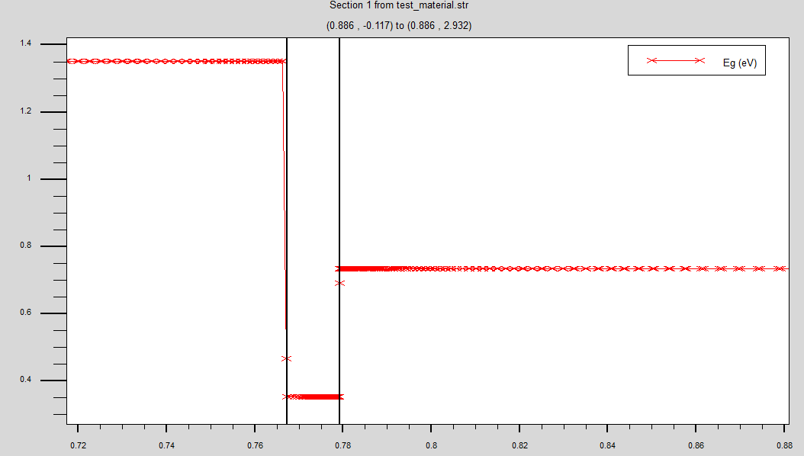
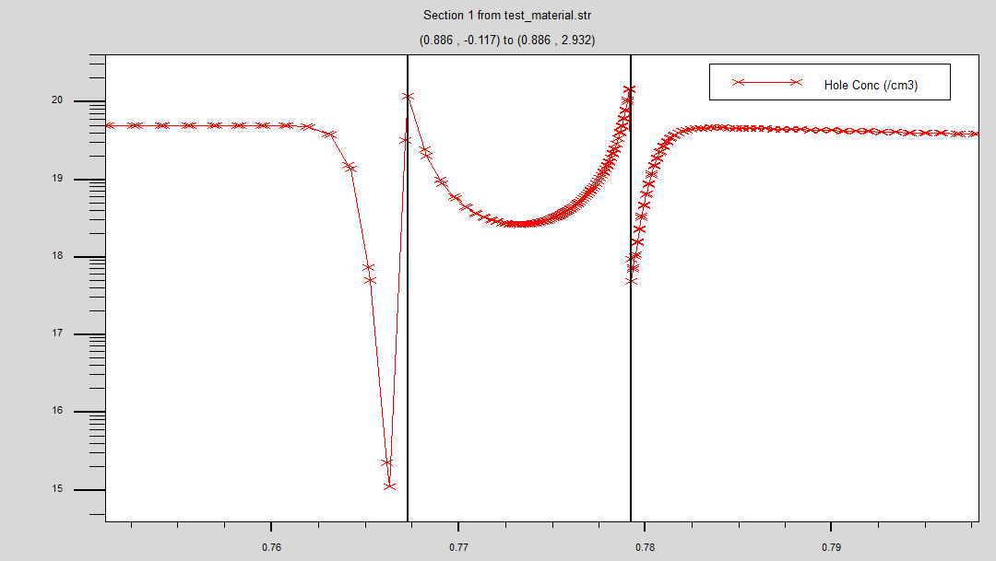
Discontinuity of Eg

Slide 35
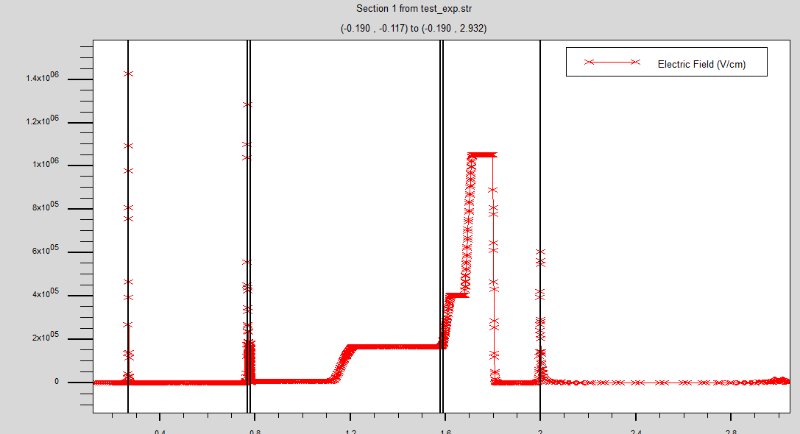
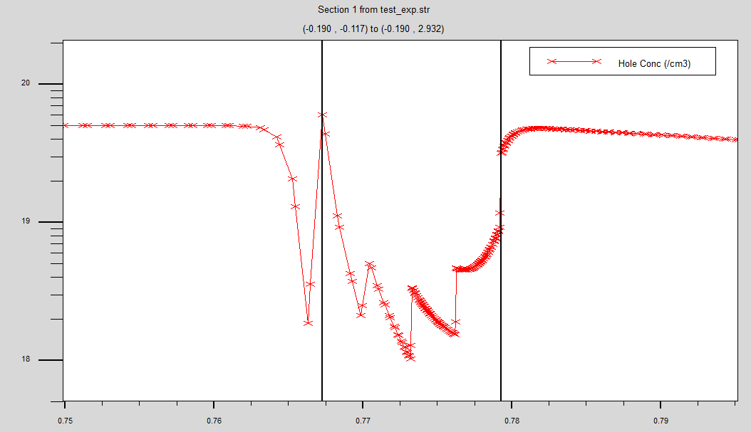
Continuity of Eg

Slide 36
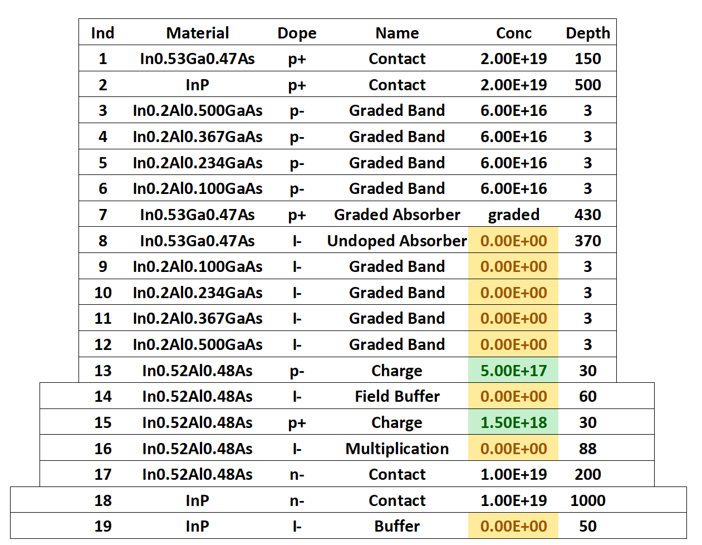
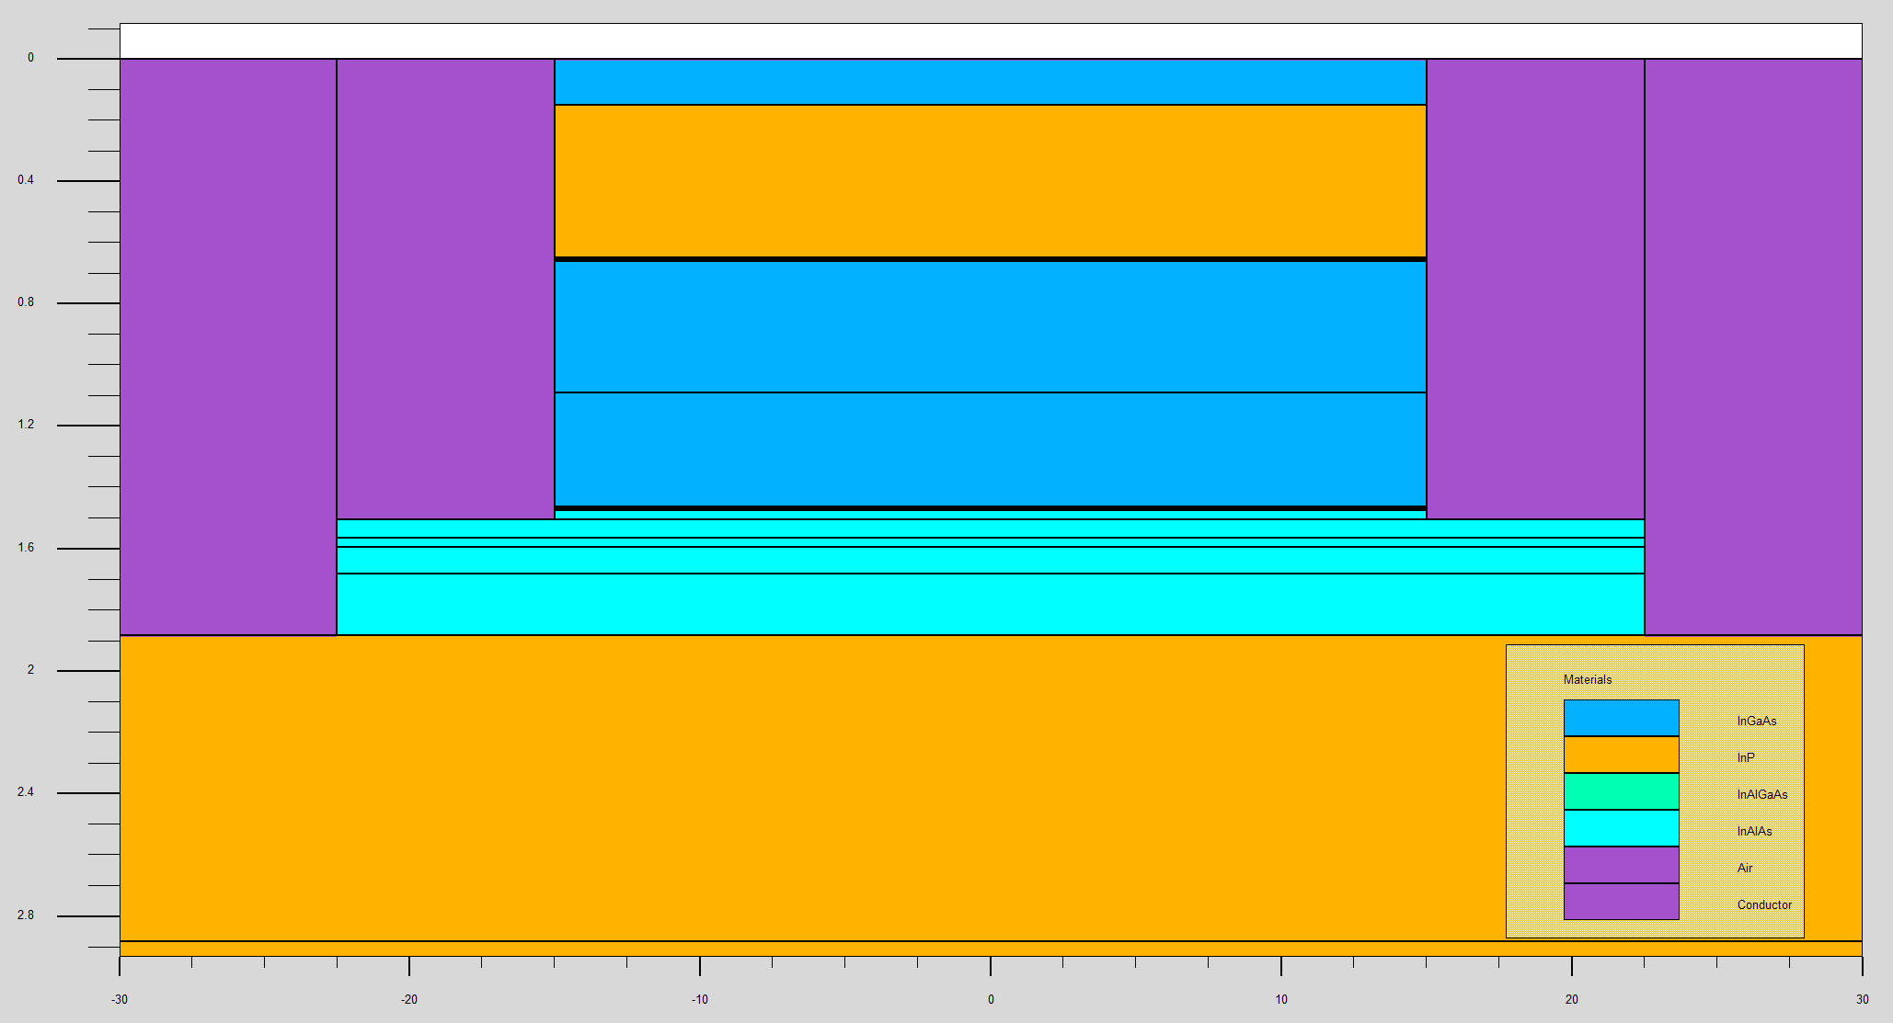
Initial Value

Slide 37
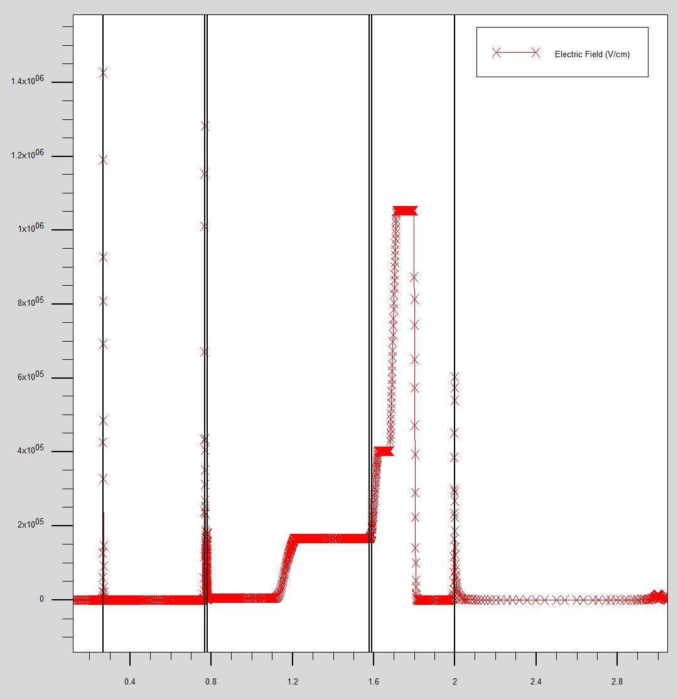
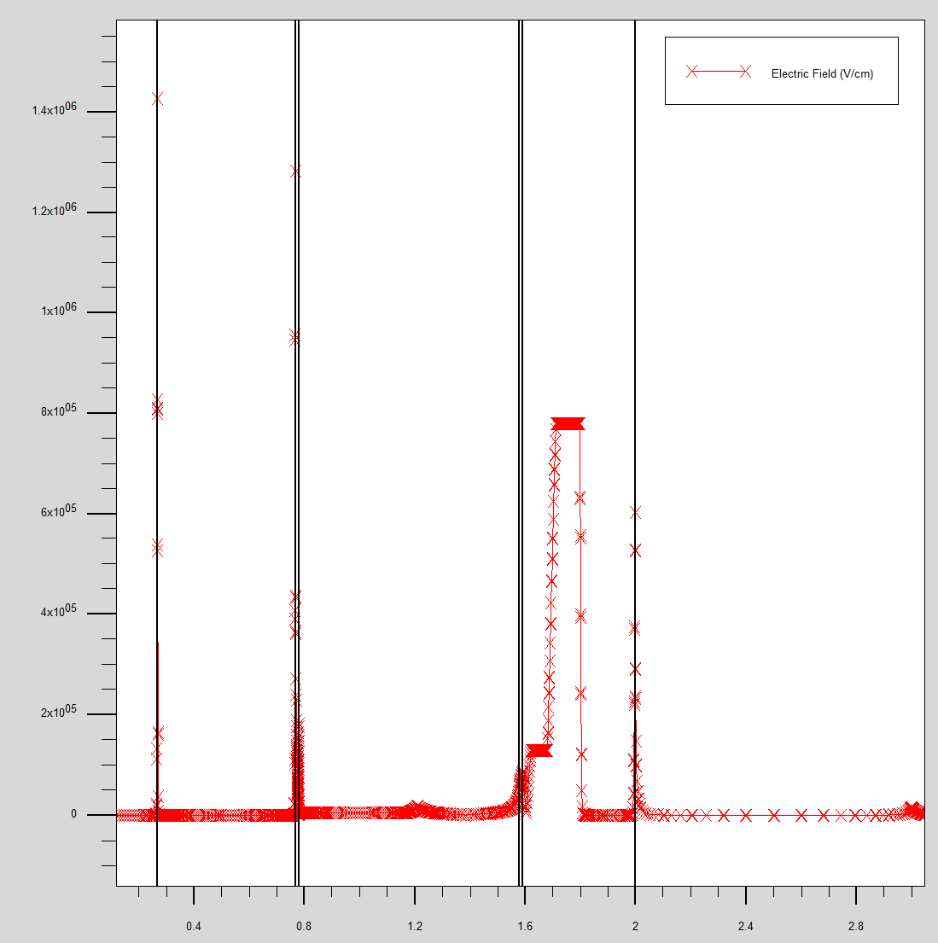
Initial Value
0.9Vbr_-21V:
1052.6 kV/cm
Punch_-8V:
779.88 kV/cm

Slide 38
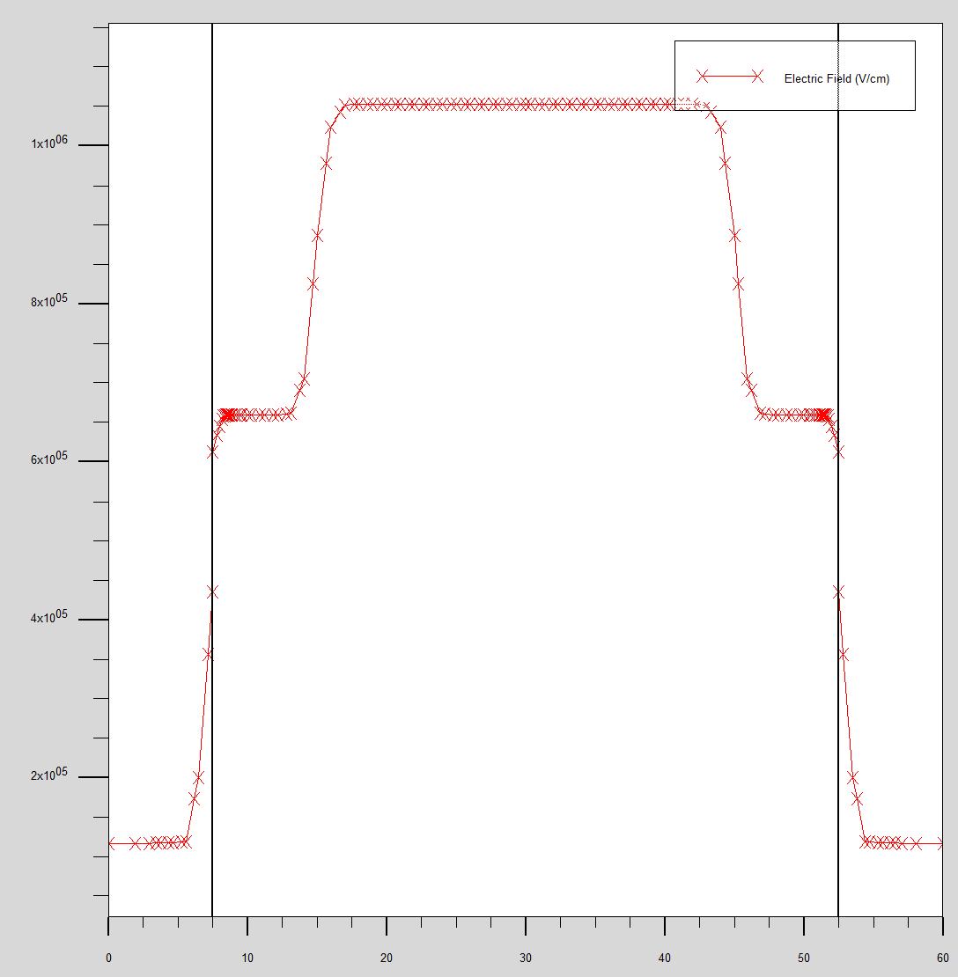
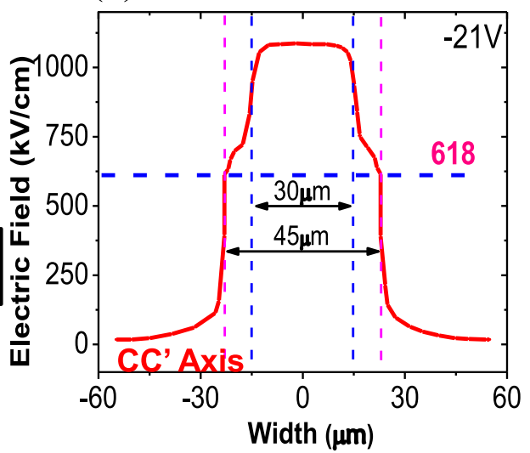
Initial Value
612.10 kV/cm

Slide 39
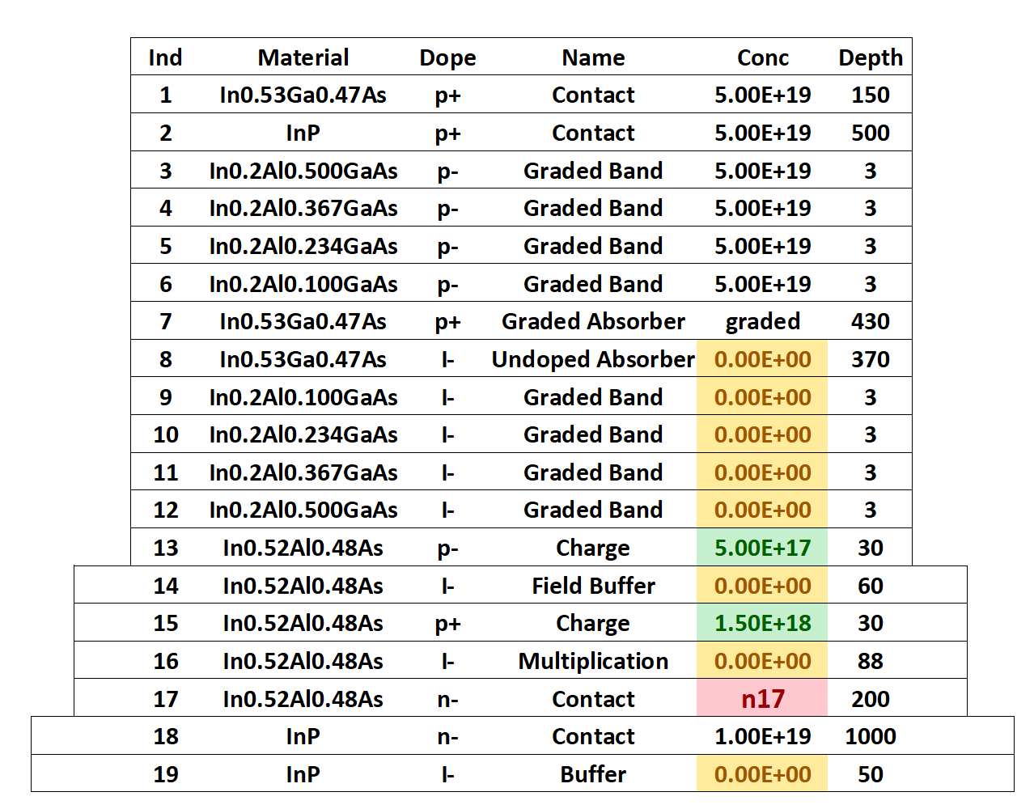
n17
n17 | 1.00E+18 | 3.00E+18 | 5.00E+18 | 7.00E+18 | 9.00E+18 | 1.00E+19 | 3.00E+19 | 5.00E+19
Center | 1001.1 | 1038.1 | 1046.2 | 1049.8 | 1051.8 | 1052.6 | 1057.1 | 1058.1
Margin | 610.14 | 611.62 | 612.02 | 611.98 | 612.18 | 612.12 | 612.4 | 612.52

Slide 40
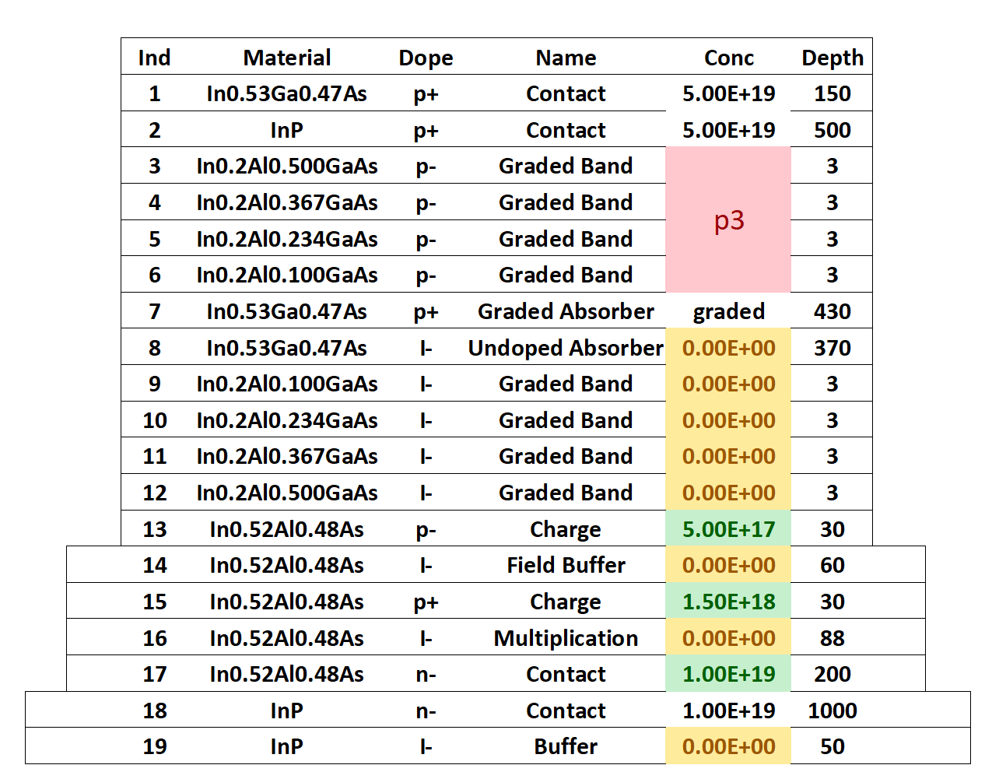
p3
p3 | 1.00E+14 | 1.00E+15 | 1.00E+16 | 2.00E+16 | 4.00E+16 | 6.00E+16 | 8.00E+16 | 1.00E+17 | 1.00E+18 | 1.00E+19
Center | 1052.6 | 1052.6 | 1052.6 | 1052.6 | 1052.6 | 1052.6 | 1052.6 | 1052.6 | 1052.6 | 1052.6
Margin | 612.16 | 612.18 | 612.2 | 612.22 | 612.14 | 612.26 | 612.2 | 612.12 | 612.18 | 612.24

Slide 41
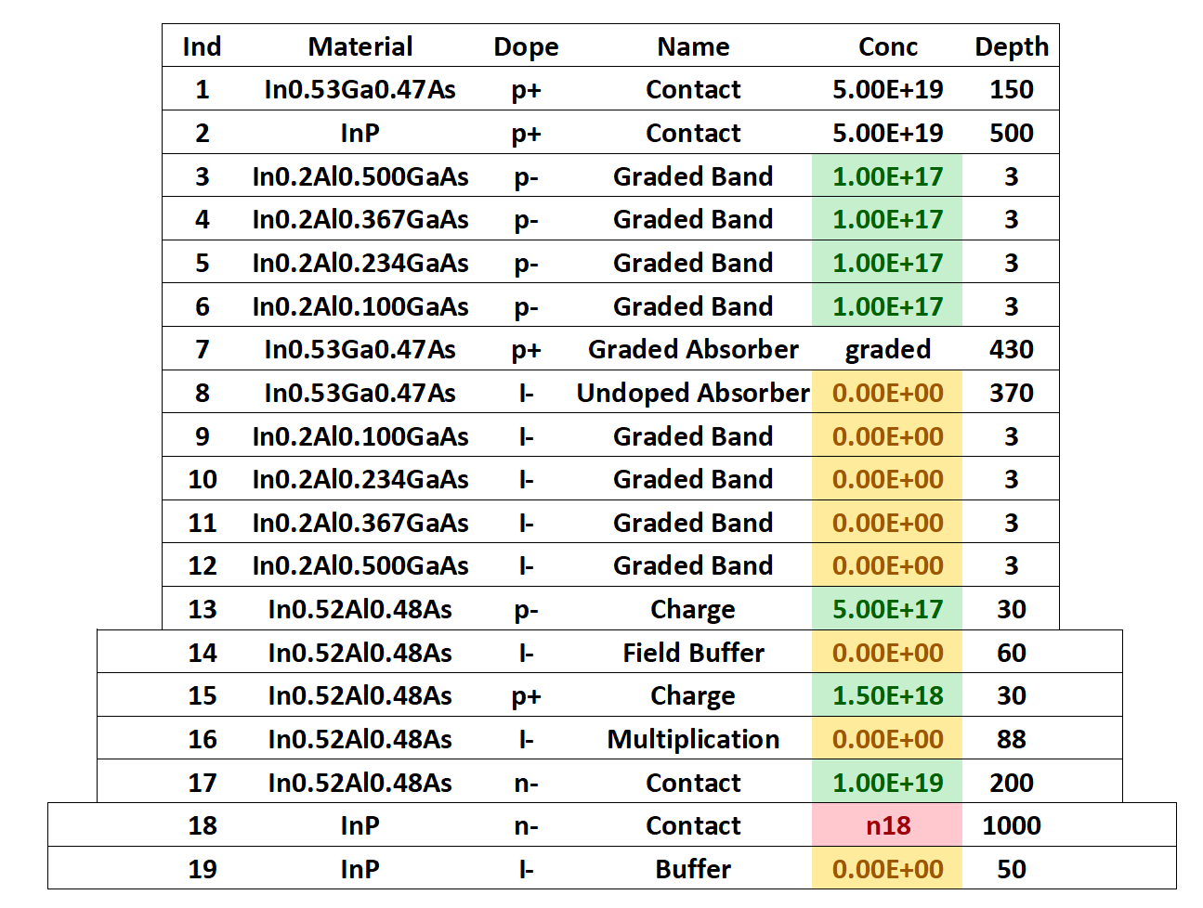
n18
n18 | 1.00E+14 | 1.00E+15 | 1.00E+16 | 1.00E+17 | 1.00E+18 | 1.00E+19
Center | 1052.6 | 1052.6 | 1.05E+03 | 1.05E+03 | 1052.6 | 1052.6
Margin | 612.21 | 612.12 | 612.24 | 612.03 | 612.24 | 612.14

Slide 42
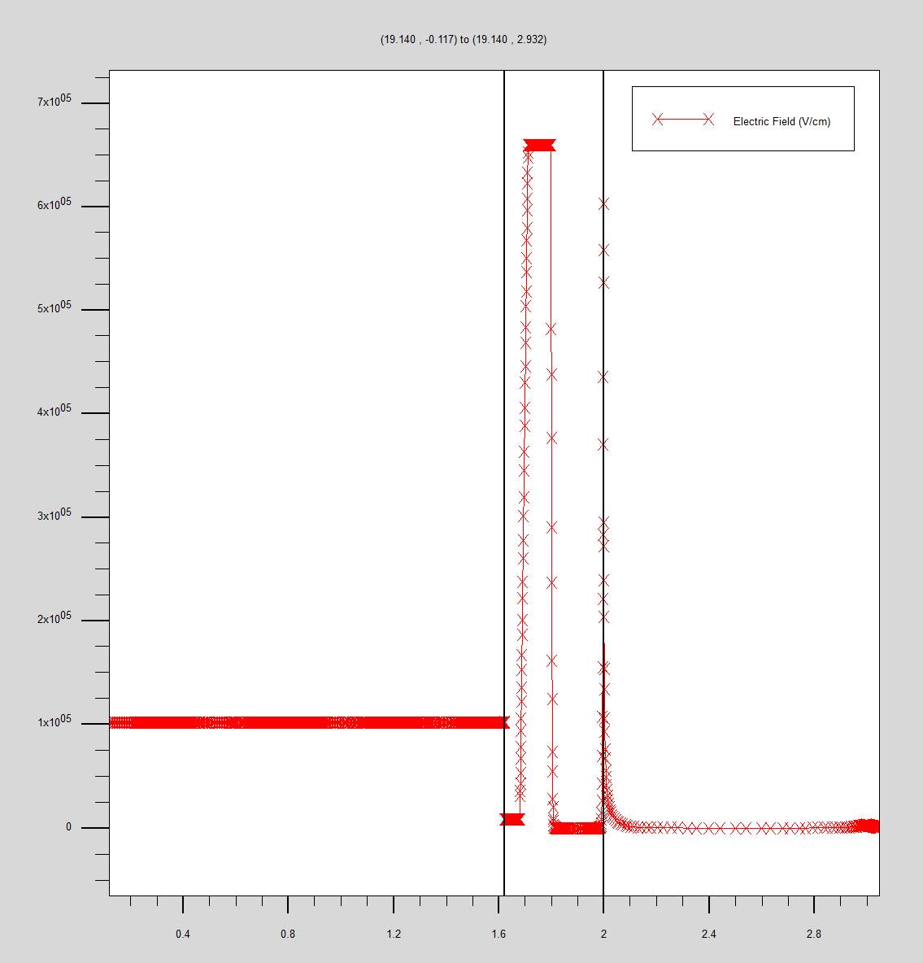
Dual charge layer

Slide 43
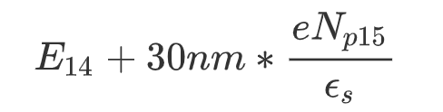

Dual charge layer

Slide 44
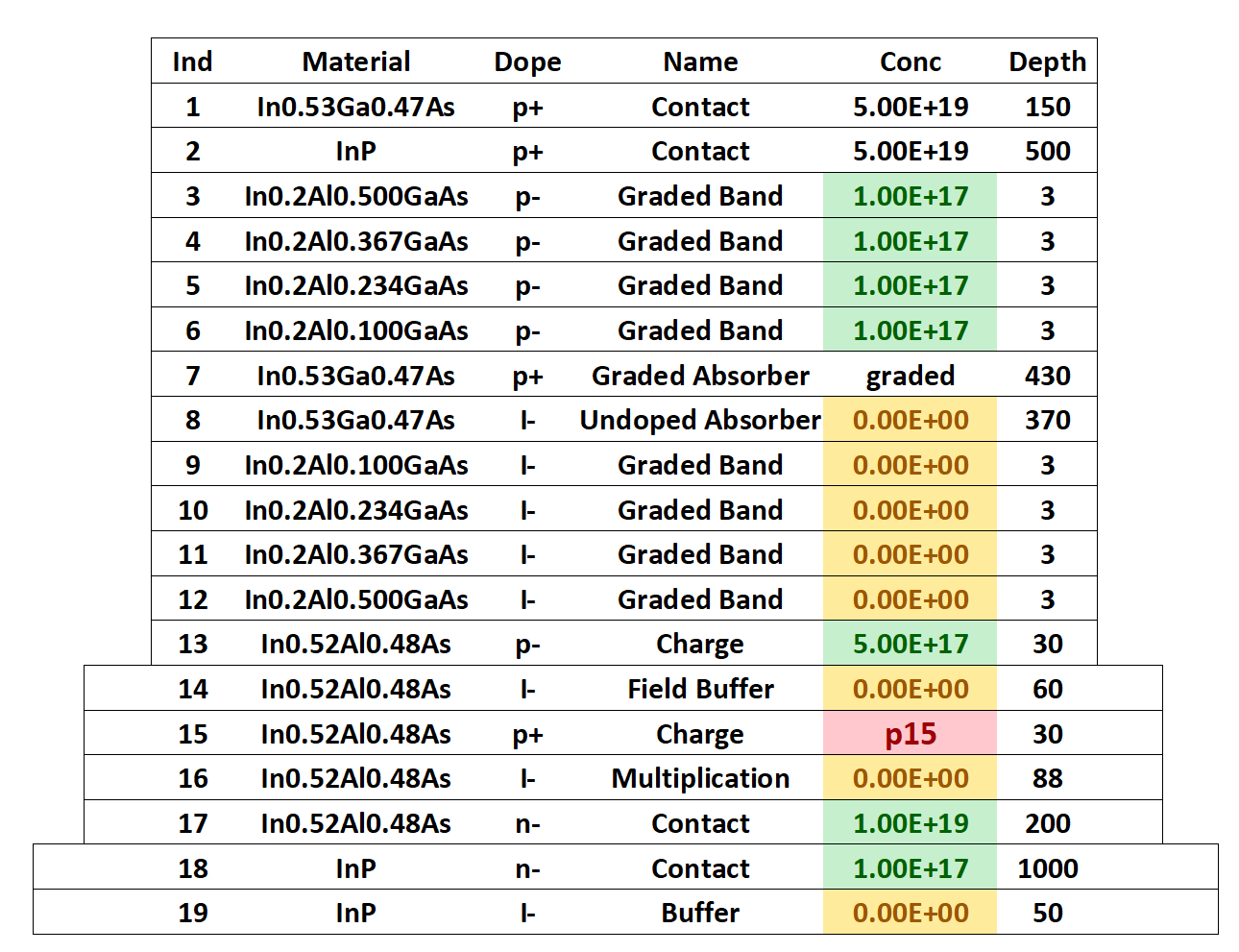
p15
p15 | 1.00E+18 | 1.50E+18 | 2.00E+18 | 2.50E+18
Center | 873.6 | 1052.6 | 1.23E+03 | 1407.8
Margin | 416.6 | 612.22 | 807.62 | 1003.1

Slide 45
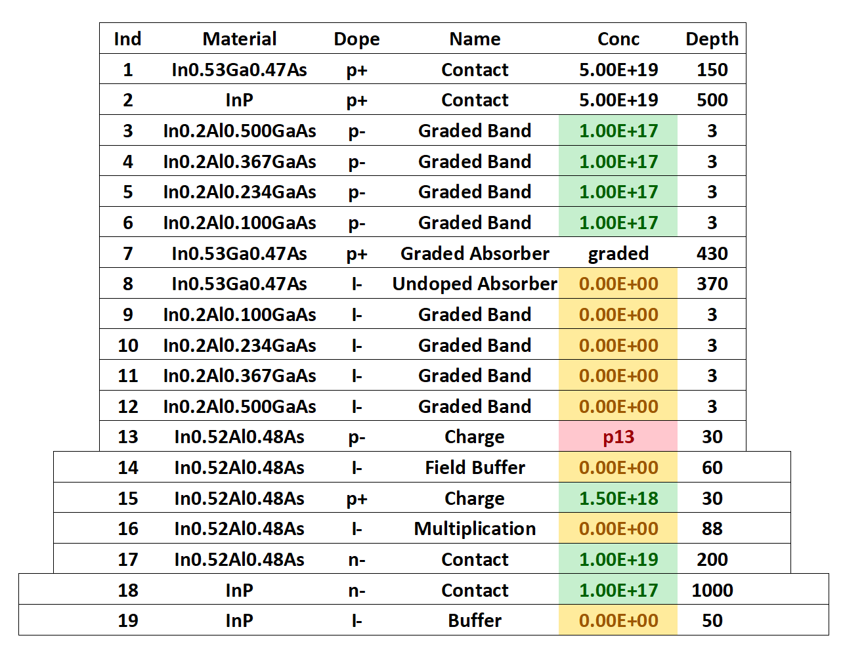
p13
p13 | 3.50E+17 | 4.00E+17 | 4.50E+17 | 5.00E+17 | 5.50E+17 | 6.00E+17 | 6.50E+17 | 7.00E+17 | 7.50E+17 | 8.00E+17
Center | 1008.3 | 1023.1 | 1037.8 | 1052.6 | 1067.3 | 1081.9 | 1096.6 | 1111.2 | 1125.8 | 1140.4
Margin | 612.1 | 612.2 | 612.05 | 611.97 | 612.1 | 612.2 | 612.12 | 612.16 | 612.12 | 612.2

Slide 46
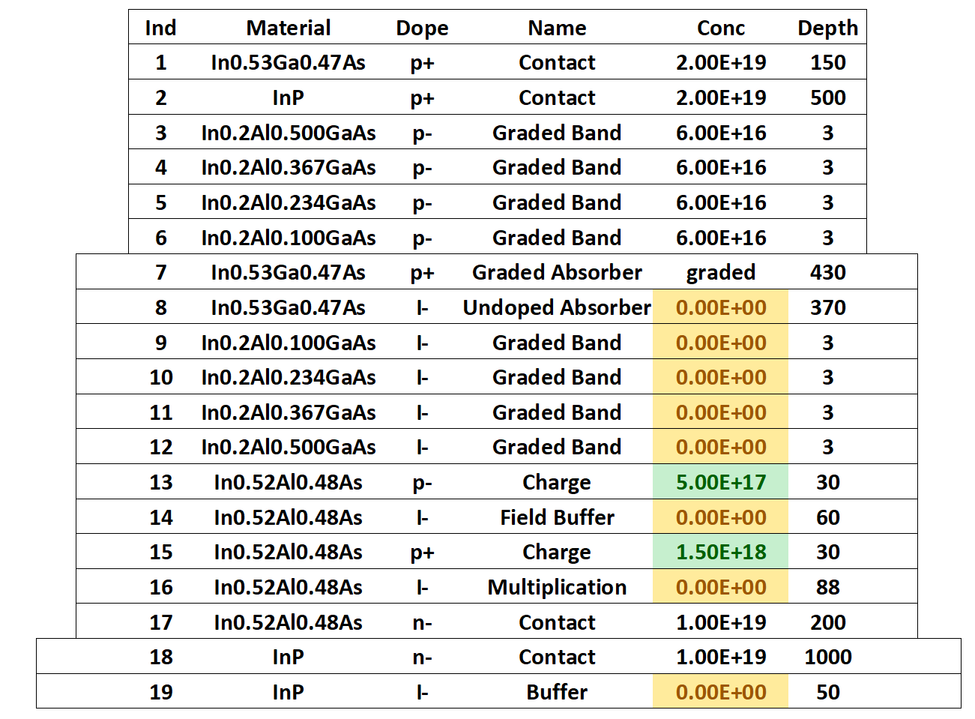
Structure B comparison

Slide 47
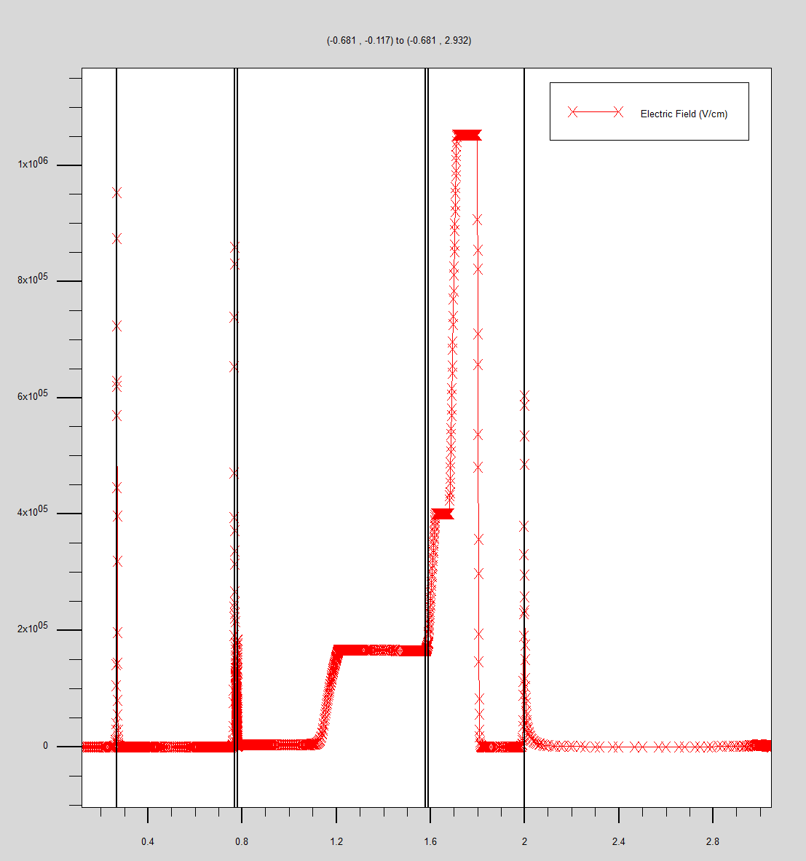
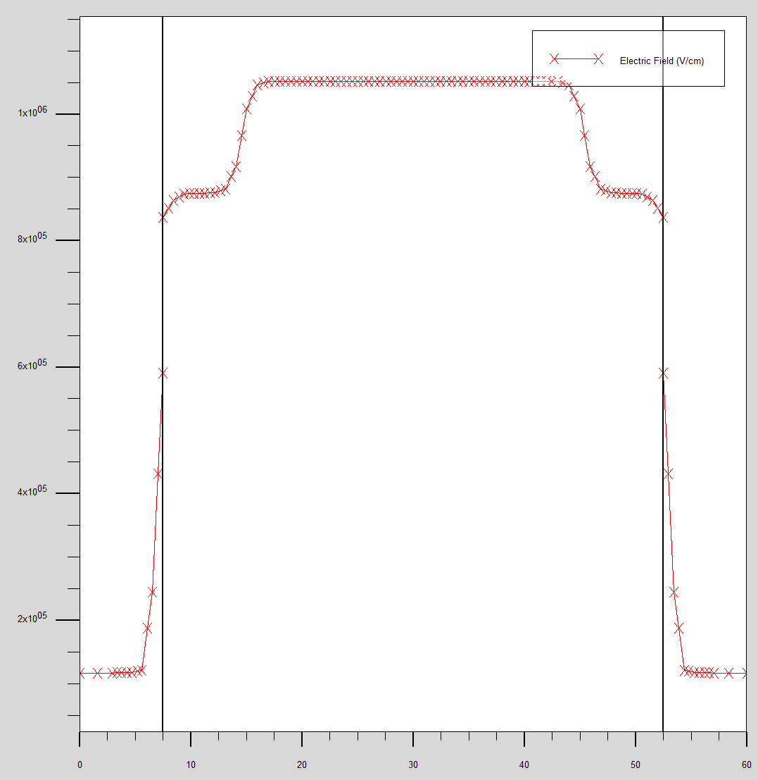
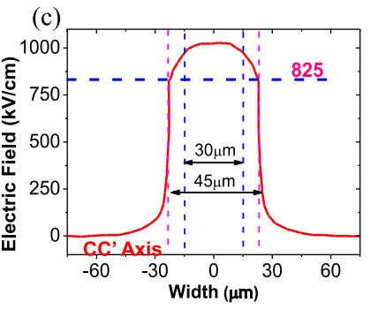
Structure B comparison
1052.4kV/cm
837.68kV/cm

Slide 48
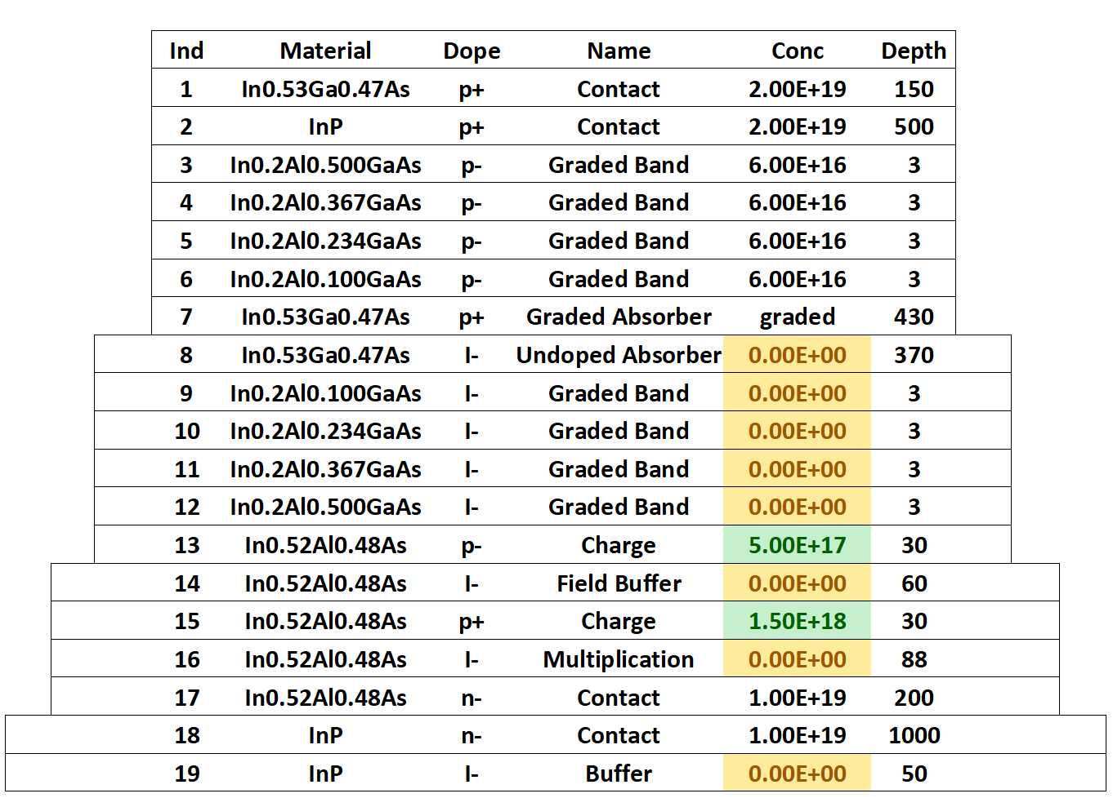
Structure C comparison

Slide 49
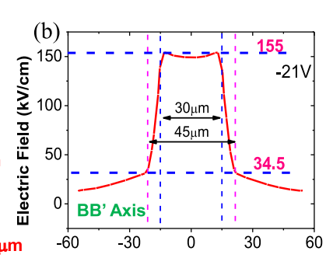
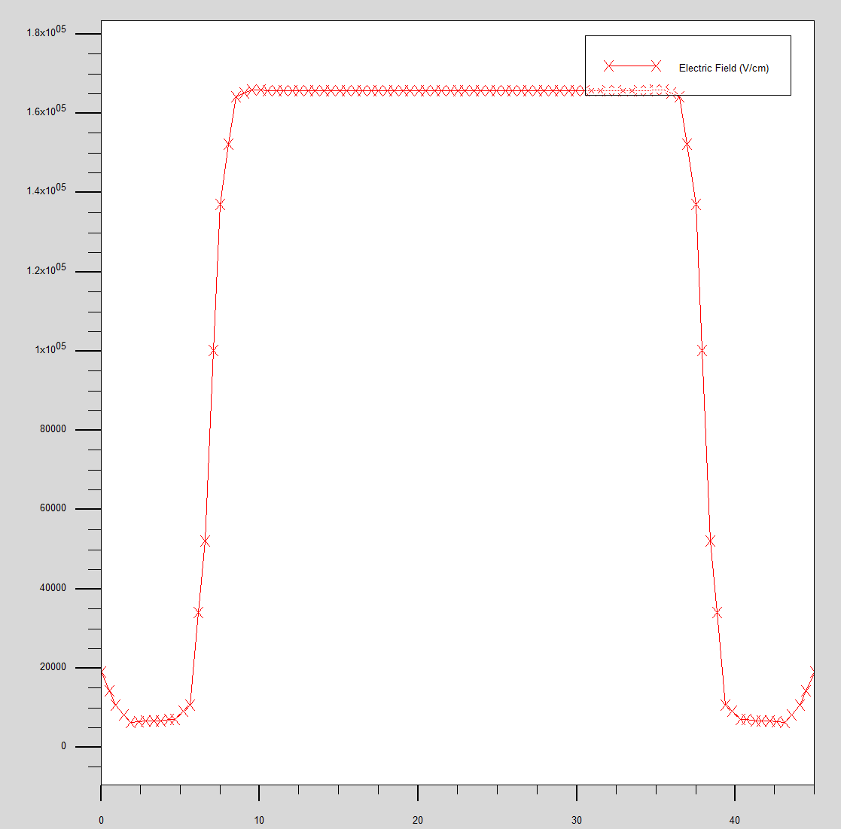
Structure C comparison
165.78kV/cm
64kV/cm

Slide 50



Structure C comparison
1052.4kV/cm
629.04kV/cm

Slide 51

i
i | 1.00E+10 | 1.00E+11 | 1.00E+12 | 1.00E+13 | 1.00E+14 | 1.00E+15
Center | 1052.6 | 1052.6 | 1052.6 | 1052.6 | 1052.6 | 1051.8
Margin | 612.16 | 612.11 | 612.26 | 612.22 | 612.56 | 613.72

Slide 52




Graded doping type

Slide 53


Current
Dark Current
Light Current

